Slide 1
Handwritten Arabic Characters Segmentation Based on Column Density Variance Analysis
PROGRAMMING TOOLS AND METHODS FOR MECHATRONICS ENGINEERS
Final project
Done by :
Yusri Taha Al-Sanaani
Supervised by:
Dr. Khaled Hatamleh

Slide 2
Literature
Photovoltaic (PV) systems:
Segmentation techniques of handwritten text in different language can't be applied for Arabic
The literature of handwriting Arabic segmentation contains different techniques based on different ideas.
JUST-2015

Slide 3
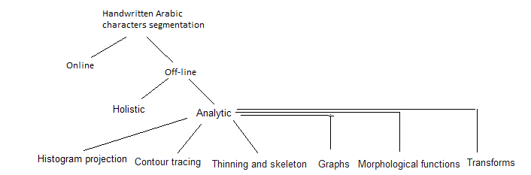
MPPT Control for PV System
The overall Arabic characters segmentation
JUST-2015

Slide 4
MPPT Control for PV System
On-line vs. off-line segmentation
These relies on the availability of text to be segmented.
On-line segmentation: text is segmented and recognized while writing. It is more easier than off-line model, where some temporal helpful information is available; such as pen direction, speed, pressure.. etc.
Off-line segmentation: text is segmented after it has been written.
JUST-2015

Slide 5
MPPT Control for PV System
Analytic vs. Holistic models
Analytic (explicit segmentation): it aims to divide each connected block (word/subword) to segments then recognize it.
Holistic (implicit segmentation, segmentation-free): it aims to avoid difficulties of segmentation phase by recognizing the entire word as a whole, without segmentation.
It reports a good results, but exhausted large amounts of memory and training time.
It is static for trained words only.
.
JUST-2015

Slide 6
MPPT Control for PV System
Segmentation based on histogram and baseline.
Horizontal and/or vertical histogram projection represents the image in 1-D instead of 2-D.
Baseline is determined by horizontal projection, it is a line (row of pixels) having maximum number of text pixels.
It useful in determining dots and diacritics.
It has to accompanied with other techniques.
JUST-2015

Slide 7
Methodology
Observation about Arabic characters says that each character beginning with columns density more than the line connected it to previous character in the same word.
Study columns density to specify those points.
One dimension instead of two.
JUST-2015

Slide 8
MPPT Control for PV System
Over all steps.
preprocessing
Dots and diacritics removing
Lines and Words segmentation
Characters segmentation
Column density calculation
JUST-2015
JUST-2015

Slide 9
MPPT Control for PV System
Pre-processing:
Thresholding
(thr=200)
Convert to binary image
Morphological opening at (thr=30)
JUST-2015

Slide 10
MPPT Control for PV System
Final Project:
Maximum Power Point Tracker method based on Fuzzy Logic Controller is the proposed method of final project.
Research Methodology:
MATLAB and Simulink will be employed for simulation study.
JUST-2015

Slide 11
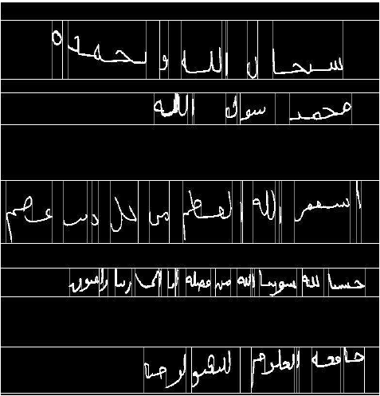
Lines and words segmentation:
JUST-2015

Slide 12
Dots and diacritics removing:
  Dots and diacritics affect column density analysis
  Column density calculation:
  Characters segmentation:
    If average density of group of columns to the left is greater than the average of density of columns to the right ,the it considered as a probable segmentation point
    Exception for multilevel characters(containing holes or loops) ج, ح, خ, ع, غ, ك ), م, ه, و, ص, ض, ط, ظ, ة)
JUST-2015

Slide 13
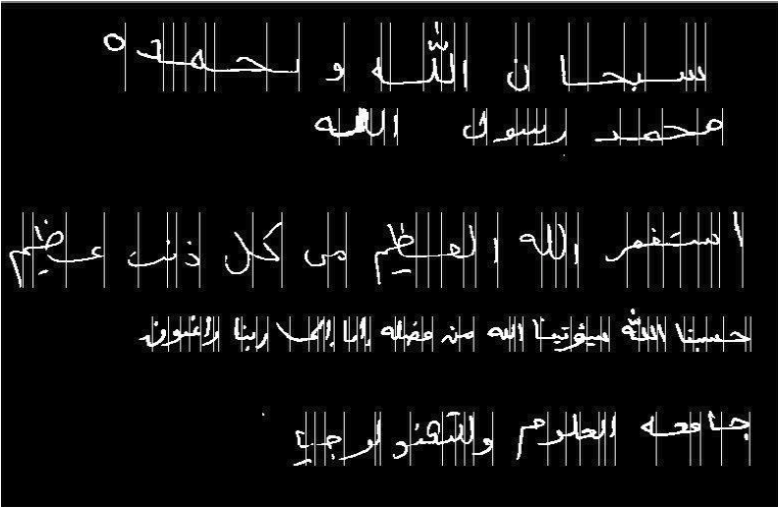
JUST-2015

Slide 14
References
[1] Huan-Liang Tsai, Ci-Siang Tu, and Yi-Jie , “Development of Generalized PhotovoltaicModel Using MATLAB, SIMULINK,”, Proceedings of the World Congress on Engineering and Computer Science,WCECS 2008, October 22 - 24, 2008, San Francisco.
[2] Youcef Soufi, Mohcene Bechouat, Sami Kahla, Kais Bouallegue," Maximum power point tracking using fuzzy logic control for photovoltaic system" , 3rd International Conference on Renewable Energy Research and Applications, 19-22 Oct 2014, Milwakuee, USA
[3] S. Vasantharaj, G. Vinodhkumar, M. Sasikumar," Development of a Fuzzy Logic based, Photovoltaic Maximum Power Point Tracking Control System using Boost Converter",
Chennai and Vivekanandha College of Technology for women, Third International Conference on Sustainable Energy and Intelligent System ,VCTW, Tiruchengode, Tamilnadu, India , 27-29 December, 2012.
[4] M.S. Aït Cheikh, C. Larbes, G.F. Tchoketch Kebir and A. Zerguerras," Maximum power point tracking using a fuzzy logic control scheme", Revue des Energies Renouvelables Vol. 10 N°3 (2007) 387 – 395
[5] Theodoros L. Kottas, Yiannis S. Boutalis,Athanassios D. Karlis," New Maximum Power Point Tracker for PV Arrays Using Fuzzy Controller in Close Cooperation With Fuzzy Cognitive Networks", IEEE TRANSACTIONS ON ENERGY CONVERSION, VOL. 21, NO. 3, SEPTEMBER 2006
[6] D. P. Hohm and M. E. Ropp," Comparative Study of Maximum Power Point Tracking Algorithms", PROGRESS IN PHOTOVOLTAICS: RESEARCH AND APPLICATIONS Prog. Photovolt: Res. Appl. 2003; 11:47–62 (DOI: 10.1002/pip.459)
[7] Chao Zhang, Dean Zhao," MPPT with Asymmetric Fuzzy Control for Photovoltaic System", School of Electrical and Information Engineering of Jiangsu University,Zhenjiang, 212013, P.R.China
JUST-2015

